Slide 1
Verilog Design Building Blocks for Digital Signal Processing
EE417 Logic Design Using FPGAs

Slide 2
Differentiator
A differentiator provides a measure of the sample-to-sample change in a signal.
module differentiator # (parameter word_size = 8) (
output [word_size -1: 0] data_out,
input [word_size -1: 0] data_in,
input hold,
input clock, reset );
reg [word_size -1:0] buffer;
assign data_out = data_in – buffer;
always @ (posedge clock) begin
if (reset) buffer <= 0;
else if (hold) buffer <= buffer;
else buffer <= data_in;
end
endmodule

Slide 3
Integrator
Digital Integrators accumulate running sum of sample values. Two implementations are common: The parallel and the sequential.
Parallel Integrator
module integrator_parallel # (parameter word_size = 8) (
output reg [word_size -1: 0] data_out,
input [word_size -1: 0] data_in,
input hold,
input clock, reset );
always @ (posedge clock) begin
if (reset) data_out <= 0;
else if (hold) data_out <= data_out;
else data_out <= data_out + data_in;
end
endmodule

Slide 4
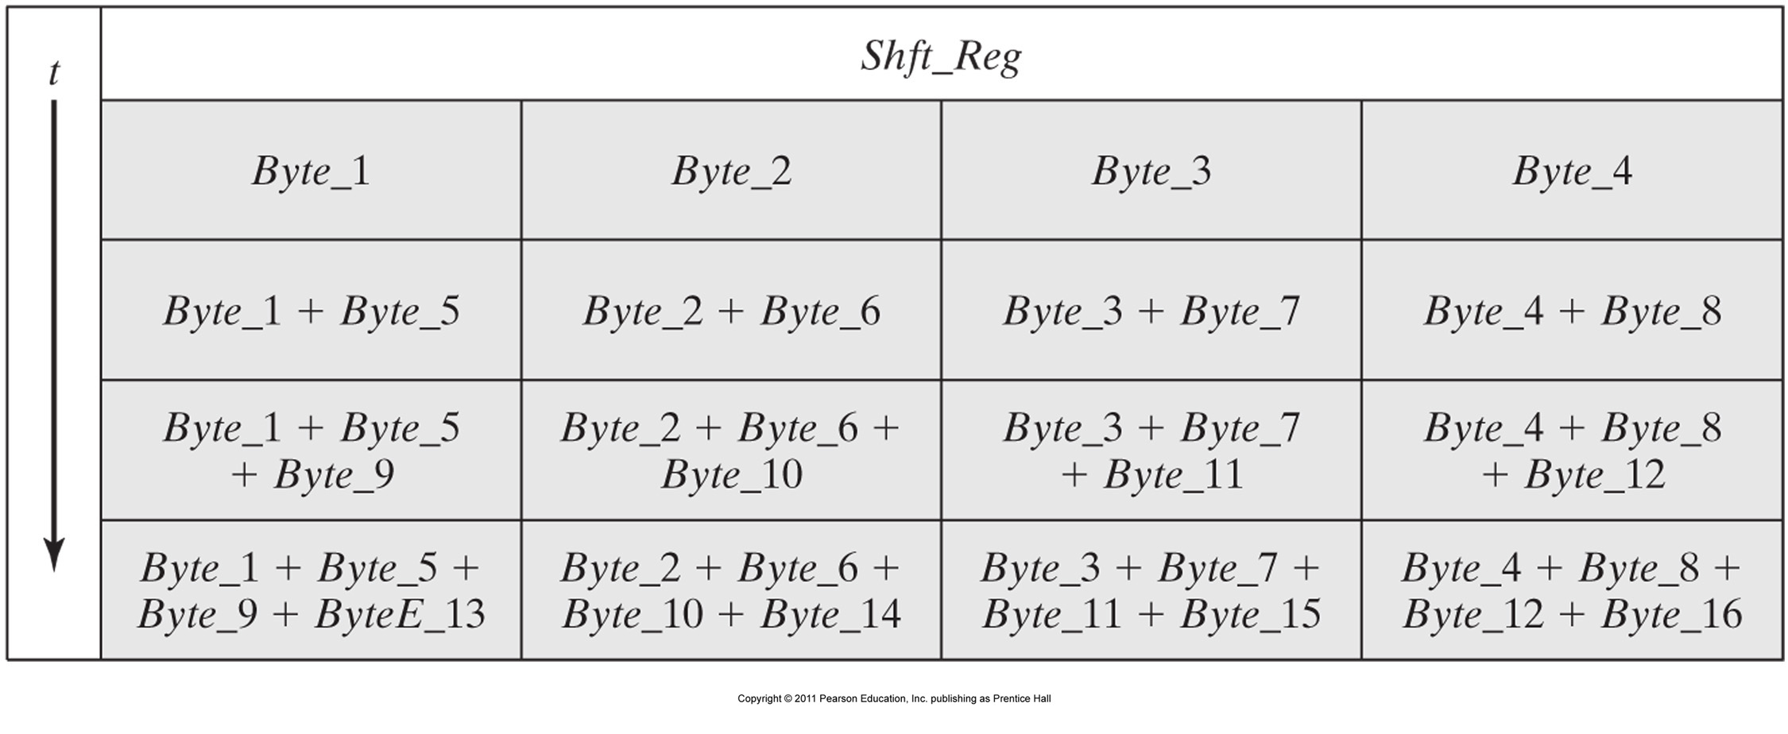
Sequential Integrator
It is common for a processor to receive data via a narrower data-path than the datapath within the processor. In this example the unit is to accumulate 32-bit words, but receives data sequentially , in 8-bit bytes.

Slide 5

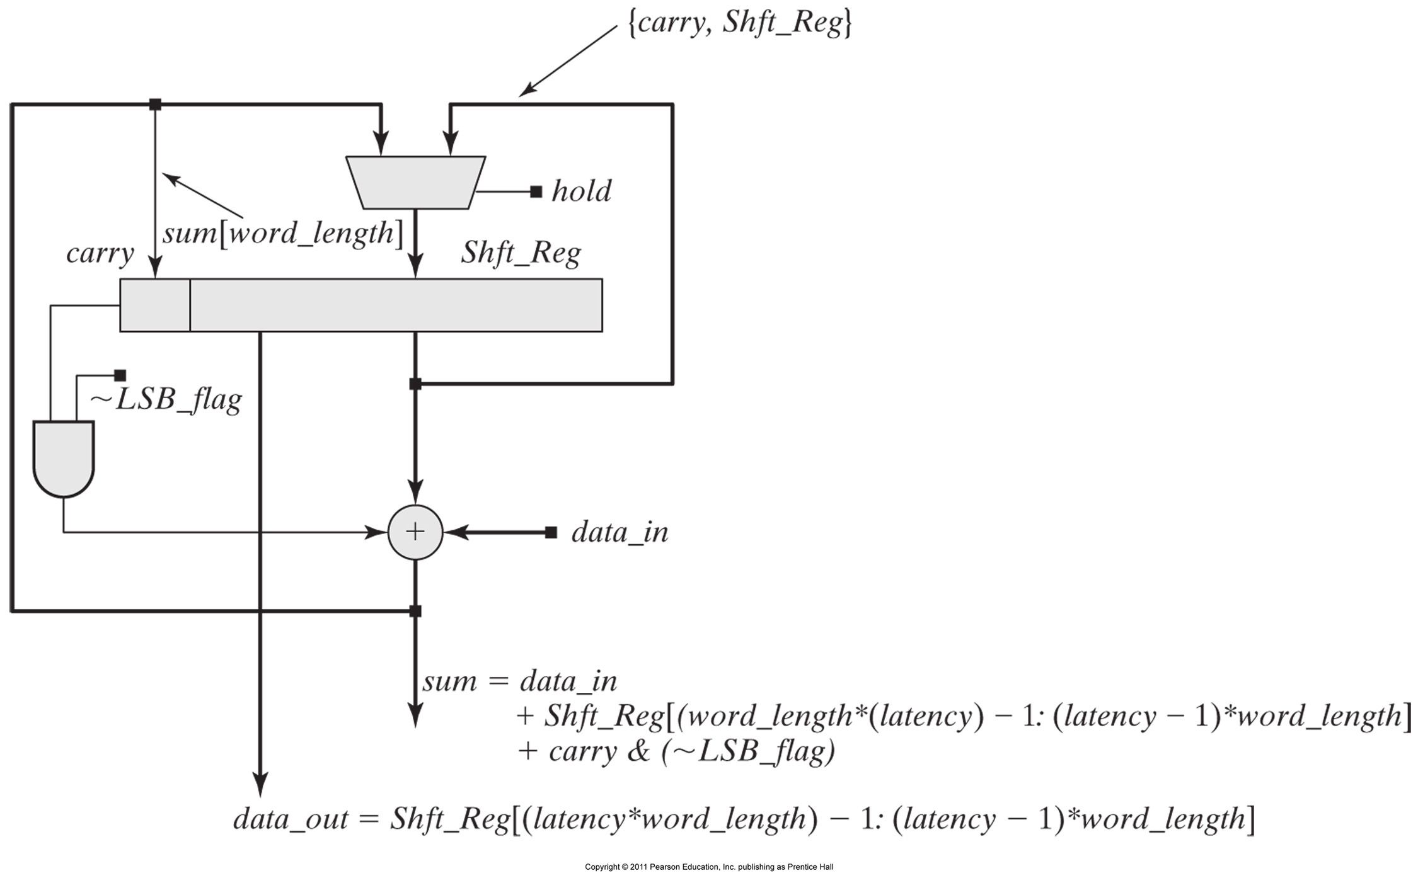
Architecture of a byte sequential Integrator

Slide 6
module Integrator_Sequential # (parameter word_length = 8, latency = 4) (
output [word_length -1: 0] data_out,
input [word_length -1: 0] data_in,
input hold, LSB_flag,
input clock, reset );
reg [(word_length*latency) -1 : 0] Shft_Reg;
reg carry;
wire [word_length : 0 ] sum;
always @ (posedge clock) begin
if (reset) begin
Shft_Reg <= 0;
carry <= 0;
end
else if (hold) begin
Shft_Reg <= Shft_Reg;
carry <= carry;
end
else begin
Shft_Reg <= {Shft_Reg [ word_length*(latency -1) - 1: 0] , sum [ (word_length-1): 0] };
carry <= sum [word_length];
end
end
assign sum = data_in
+ Shft_Reg [ (latency*word_length) – 1: (latency-1)*word_length ]
+ (carry & (~LSB_flag));
assign data_out = Shft_Reg [ (latency*word_length) – 1: (latency-1)*word_length ]
endmodule

Slide 7

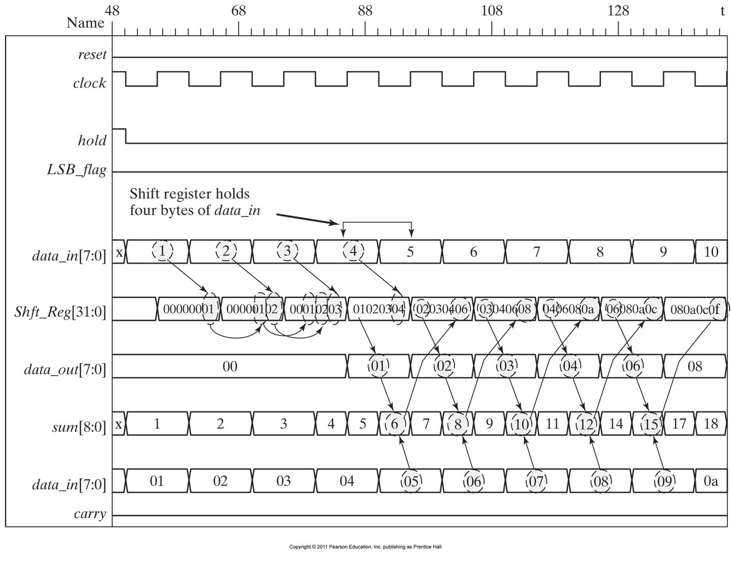

Slide 8
Decimation & Interpolation
Decimation and Interpolation filters are used to achieve sample rate conversion in digital signal processors. There is the parallel as well as the sequential versions.

Slide 9
Decimator:
module decimator_parallel # (parameter word_length = 8) (
output reg [word_length -1: 0] data_out,
input [word_length -1: 0] data_in,
input hold,
input clock, reset );
always @ (posedge clock) begin
if (reset) data_out <= 0;
else if (hold) data_out <= data_out;
else data_out <= data_in;
end
endmodule

Slide 10
module Decimator_Sequential # (parameter word_length = 8, latency = 4) (
output [word_length*latency -1: 0] data_out,
input [word_length -1: 0] data_in,
input hold, load,
input clock, reset );
reg [(word_length*latency) -1 : 0] Shft_Reg;
reg [(word_length*latency) -1 : 0] Int_Reg;
reg [(word_length*latency) -1 : 0] Decim_Reg;
always @ (posedge clock) begin
if (reset) begin
Shft_Reg <= 0;
Int_Reg <= 0;
end
else begin if (!load) begin
Shft_Reg <= {data_in, Shft_Reg [ word_length*(latency) - 1: word_length] } end
else begin
Int_Reg <= Shft_Reg;
Shft_Reg[ (word_length*latency -1) : word_length*(latency-1)] <= data_in;
end
end
always @ (posedge clock)
if (reset) Decim_Reg <= 0;
else if (!hold) Decim_Reg <= Int_Reg;
assign data_out = Decim_Reg;
endmodule

Slide 11
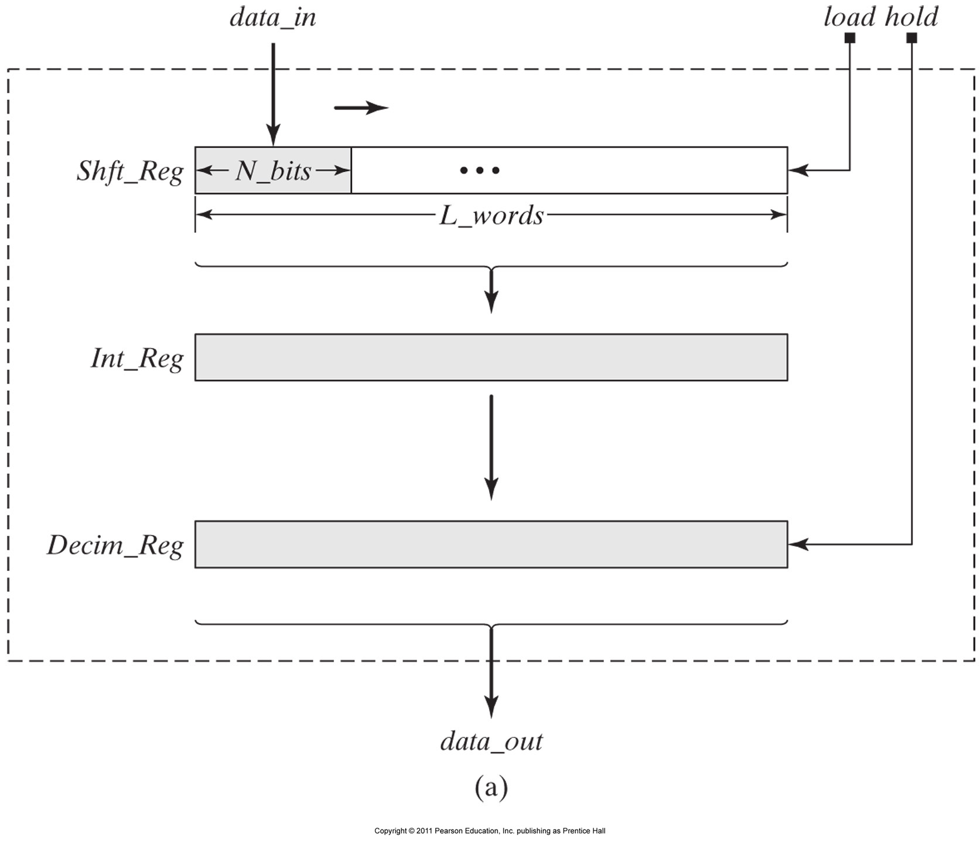

Slide 12
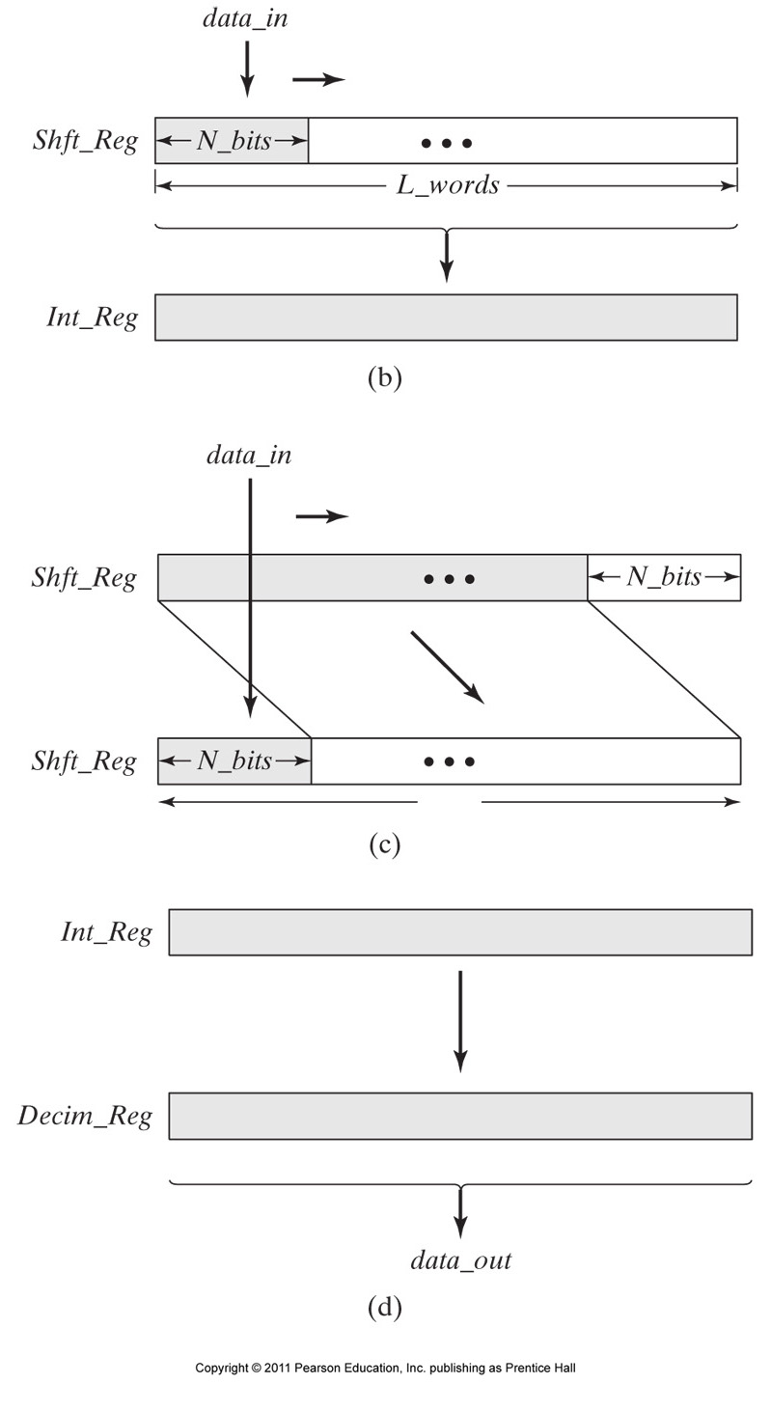

Slide 13
